Slide 1
Coffee Shop Sales Analysis

Slide 2
Objective
The main objective of this project is to analyze the retail sales data to gain actionable insights that will enhance the performance of the coffee shop.

Slide 3
Tools Used: MS Excel
Techniques Used: Data Cleansing,
Data Visualization,
Pivot Tables,
Graphs and Charts

Slide 4
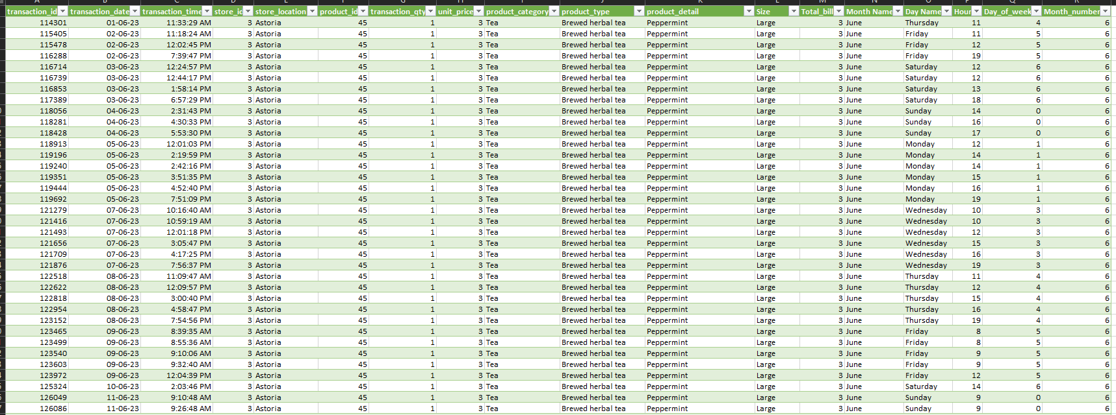
Dataset Description
The data is taken from the website Kaggle.com. The coffee shop data consists of 1,49,116 rows and 11 columns. The dataset is as follows:

Slide 5
transaction_id = transaction ID’s of customers.
transaction_date = date when the transaction was done.
transaction_time = the time when the transaction was done
store_id = unique ID of the store.
store_location = location where the store is present (Astoria, Hell’s Kitchen, Manhattan).
product_id = unique ID of the product.
transaction_qty = quantity of the products ordered.
unit_price = price of single quantity of the product.
product_category = category of the product (Bakery, Coffee, Drinking chocolate, …)
product_type = type of the product (Brewed Coffee, Brewed Herbal Tea, Black Tea, …)
product_detail = list of products (Cappuccino, Caramel Syrup, Chocolate Croissant, …)

Slide 6
Data Cleaning
The data had some missing values in rows and columns. So, we removed them.
Values were not in proper format. So converted the values in their proper format.
The dataset had some unwanted spaces in them. So removed it using “TRIM” function.
Separated the size from the “product_detail” column using “text to column” and “find & replace” functions.

Slide 7
Data Preprocessing
Calculated column “Total_bill” using “transaction_qty” and “unit_price” column.
Extracted “Month_name”, “Day_name”, “Day_of_week”, “Month_number” using “transaction_date” column.
Extracted “Hour” using “transaction_time” column.
Done this using different “Power Query Editor” functions.
Used Pivot Tables to calculate KPI’s on the dashboard.

Slide 8
Recommended Analysis
How do sales vary by day of the week and hour of the day?
Are there any peak times for sales activity?
What is the total sales revenue for each month?
How do sales vary across different store locations?
What is the average price/order per person?
Which products are the bestselling in terms of quantity and revenue?
How do sales vary by product category and type?

Slide 9
Data Analysis
How do sales vary by day of the week and hour of the day?
So, sales are high during morning time between 7am to 10am.
Sales are little bit moderate during afternoon and evening time.
Are there any peak times for sales activity?
Yes. The sales are usually high in the morning period between 7am – 10 am.

Slide 10
What is the total sales revenue for each month?
- Sales revenue for each month is as follows: January – $ 81,677.14 February – $ 76,145.19 March – $ 98,834.68 April – $ 1,18,941.08 May – $ 1,56,4727.76 June – $ 1,66,485.88

Slide 11
How do sales vary across different store locations?
“Hell’s Kitchen” with store_id: 8 contributes ($ 2,36,511.17) maximum sales to the coffee shop.
“Astoria” with store_id: 3 is contributes ($ 2,32,243.91) second maximum sales to the coffee shop.
“Lower Manhattan: with store_id: 5 contributes ($ 2,30,057.25) least sales to the coffee shop.

Slide 12
What is the average price/order per person?
The average price per person is $ 4.69.
The average order per person is 1.4.

Slide 13
Which products are the bestselling in terms of quantity and revenue?
The top 5 best selling products are as follows:
Barista Espresso generating highest revenue ($ 91,406.20)
Brewed Chai Tea ($ 77,081.95)
Hot Chocolate ($ 72,416.00)
Gourmet Brewed Coffee ($ 70,034.60)
Brewed Black Tea ($ 47,932.00)

Slide 14
Conclusion:
We can observe that “Coffee” is the highest selling product which contributes for around (39%) of sales followed by “Tea” which contributes (28%).
Least sold products are “Packaged Chocolate”, “Loose Tea” & “Flavors”.
Around (31%) people order in “Regular” size cup.
The total footfall of the shop i.e the number of customers visited the store are 1,49,116.

Slide 15
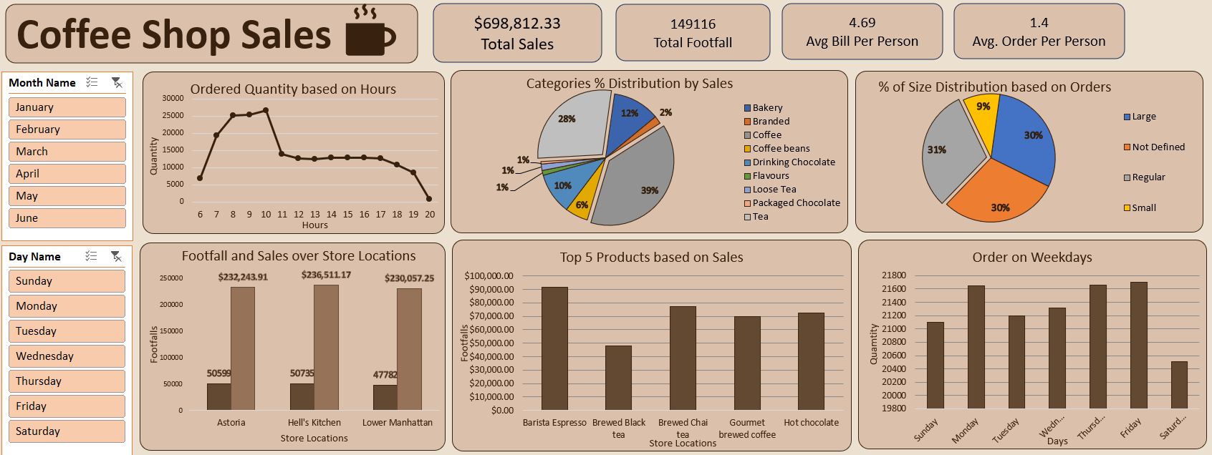
Dashboard:

Slide 16
Thank You.

